Slide 1
Introduction to Simulation and Modeling

Slide 2
Project Planning
(Lecture 9)

Slide 3
Simulation Project Manager Functions
There are five generally accepted project manager functions that will affect the success or failure of the simulation project:
Planning
Organizing
Motivating
Directing
Controlling

Slide 4
Planning
The first responsibility of the project manager is to ensure that a proper and effective plan for the simulation project is in place.
This process includes the development of a work breakdown structure and a Gantt chart.
A work breakdown structure is the successive division of project tasks to the point that individual responsibility and accountability can be assigned.
A Gantt chart illustrates the duration and relationships among the work breakdown structure tasks.

Slide 5
Organizing
The second management function involves identifying, acquiring, and aligning the simulation project team.
The relationship between the host organizations and the different projects that the team members are assigned can be clarified through the use of a matrix organizational chart.
This is a two-axis chart. On the horizontal axis, the chart contains the host organization or department for each team member.
On the vertical axis, the chart contains the different projects that the team member or members are assigned to.

Slide 6
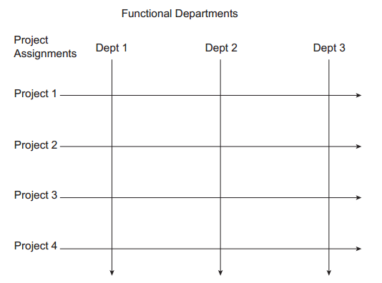
Matrix organizational chart

Slide 7
Organizing
The details of the relationships between project tasks and individuals are better served with the development of a linear responsibility chart.
A linear responsibility chart indicates who is responsible and to what degree for each of the work breakdown structure tasks.
This enables the project manager to hold individuals accountable for the performance or non performance of these tasks.

Slide 8
Motivating
The third project manager function is motivating the simulation project team.
There are a number of well-regarded motivation theories.
Three of the most popular ones include (Gibson et al., 2003):
Maslow’s hiearchy of needs theory
Alderfer’s ERG theory
Herzberg’s two-factor theory

Slide 9
Maslow’s hierarchy of needs
Maslow’s hierarchy of needs theory is based on a five-level pyramid.
According to the theory, the lowest level consists of physiologic needs such as food, water, and shelter.
The second level involves safety and security.
The third level includes friendships, affiliation, and interaction with others.
The fourth level involves self-esteem and respect from others.
The fifth and final need is to self-actualize through maximizing one’s abilities, skills, and potentials.

Slide 10
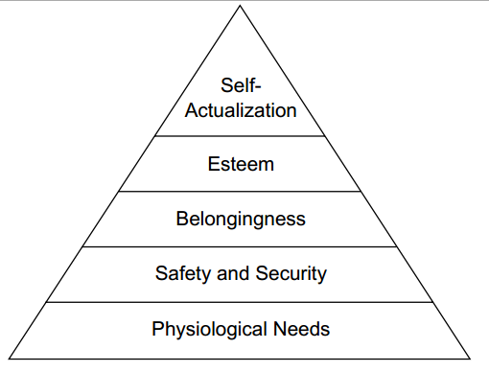
Maslow’s hierarchy of needs
According to the theory, individuals are motivated to satisfy the needs at each level of the pyramid and progress upwards.

Slide 11
Alderfer’s ERG Theory
Alderfer’s motivation theory involves three levels in contrast to Maslow’s five levels. These levels are:
Growth
Relatedness
Existence

Slide 12
Alderfer’s ERG Theory
The existence level corresponds to Maslow’s physiologic, safety, and security levels.
The relatedness level is similar to Maslow’s friendship, affiliation, and interaction level and his esteem level.
Last, the growth level corresponds to Maslow’s self-esteem level.
As with Maslow’s theory, Alderfer believed that it is necessary to fulfill lower-level needs before being interested in fulfilling higher-level needs.

Slide 13
Alderfer’s ERG Theory
Where Alderfer’s theory differs substantially from Maslow’s theory is the additional concept of a frustration–regression process.
If a person cannot fulfill his or her needs at a given level, then the previous lower-level needs regain importance to the individual.
For example, if a person is frustrated in his or her growth attempts, it becomes more important for him or her to fulfil relatedness needs.
Similarly, if a person is frustrated in his or her relatedness needs, then the existence needs take on increased importance.

Slide 14
Herzberg’s Two-Factor Theory
This theory has two independently operating factors.
The first factor involves what are known as satisfiers or motivators.
The theory states that the absence of motivators does not mean that an individual will be highly dissatisfied.
However, it does mean that the individual will have a low level of satisfaction.
Conversely, the strong presence of motivators helps insure that the individual has the will to perform.

Slide 15
Herzberg’s Two-Factor Theory
Examples of motivators include:
Feelings of achievement
Recognition
Responsibility
Opportunity for advancement
Opportunity for personal growth

Slide 16
Herzberg’s Two-Factor Theory
The second factor involves what are known as hygiene factors.
The theory states that an individual who does not have the presence of hygiene factors will be highly dissatisfied.
However, the presence of hygiene factors does not mean that the individual will be motivated. There is instead a low level of dissatisfaction.
Examples of hygiene factors include:
Good working conditions
Pay
Fringe benefits
Job security

Slide 17
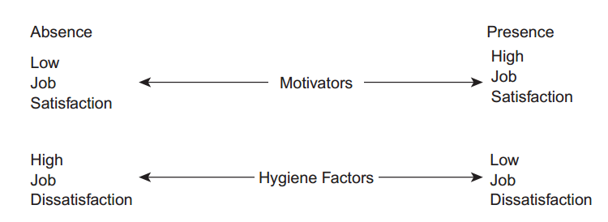
Herzberg’s Two-Factor Theory

Slide 18
Directing
The fourth project manager function is directing or leading the actions of the simulation project team.
Authority is defined as the power to command others to act or not to act.
There are two different types of authority.
De jure Authority
De facto Authority

Slide 19
Directing
De jure authority gives the project manager the legal power to acquire and utilize organizational resources.
This type of authority would typically be held by an engineering or production manager.
Awarded by some official organizational document.
De facto authority depends on other individuals complying out of respect for the individual’s unique knowledge or skills.
This type of authority is typically the kind of authority held by some sort of analyst or engineer.
Based on an individual’s personal knowledge or skills related to a particular task.

Slide 20
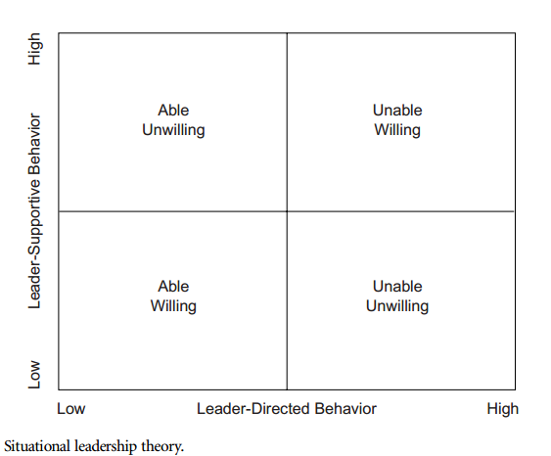
Directing (situational leadership theory)

Slide 21
Controlling
The control process consists of:
Setting project standards
Observing performance
Comparing the observed performance with the project standards
Taking corrective action
The project manager will have already set project standards as part of the time, cost, and technical performance parameters.
However, as the project progresses, the project manager may provide additional detailed project standards or adjust the project standards

Slide 22
Controlling
Finally, the project manager must take whatever ethical actions are deemed necessary to close the gap between the time, cost, or technical performance standards and the observed performance.
The project manager may need to perform personnel, organizational, or technical interventions as necessary.
These actions actually constitute a cycle, as the entire process continuously repeats throughout the project.
This means that the time, cost, and technical performance standards may need to be periodically adjusted to get or keep the project on track.

Slide 23
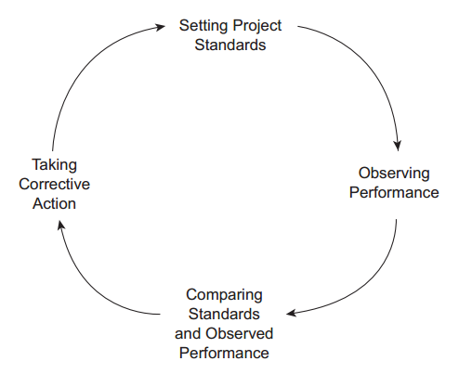
Control Cycle

Slide 24
Summary
Any Questions?

